Slide 1
Concurrency
Saint Petersburg, 2019

Slide 2
Content
1
Hardware basics
2
Software basics
3
Concurrency Java basics
4
Concurrency general concept
5
Java concurrency implementation
6
Conclusion

Slide 3
Hardware basics

Slide 4
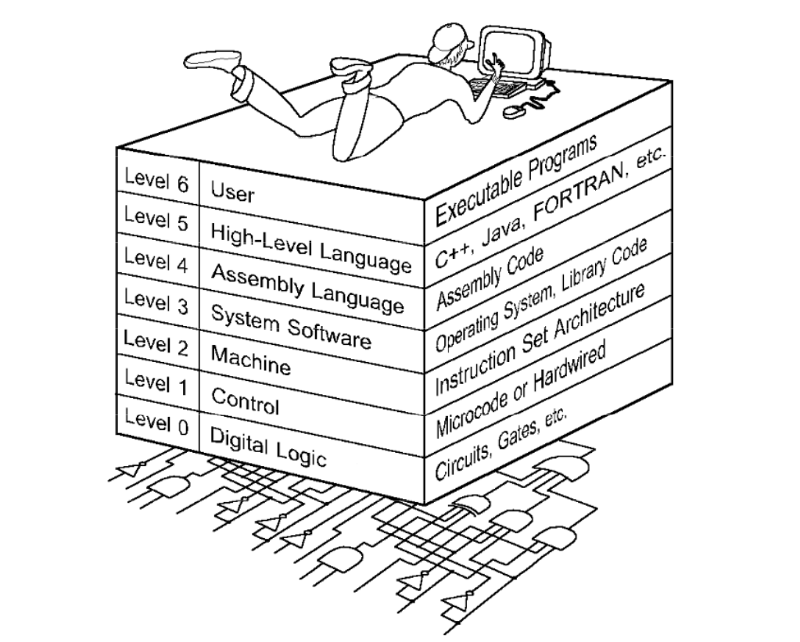
The World we are living in

Slide 5
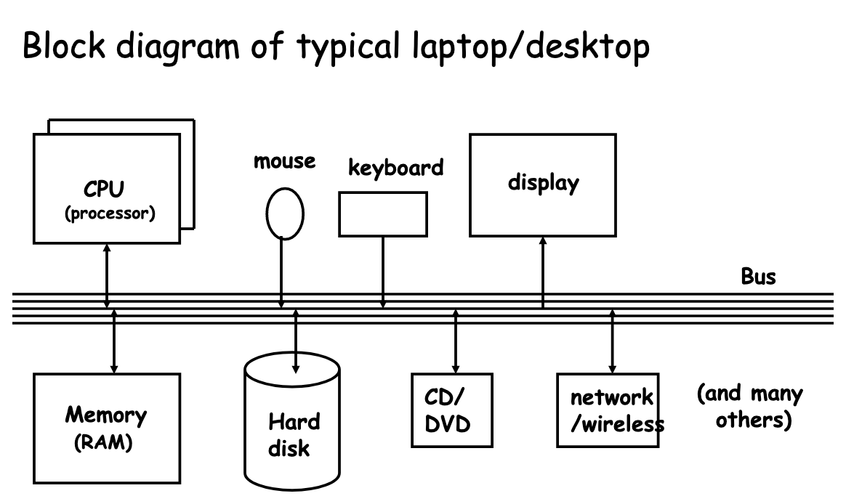
Computer architecture

Slide 6
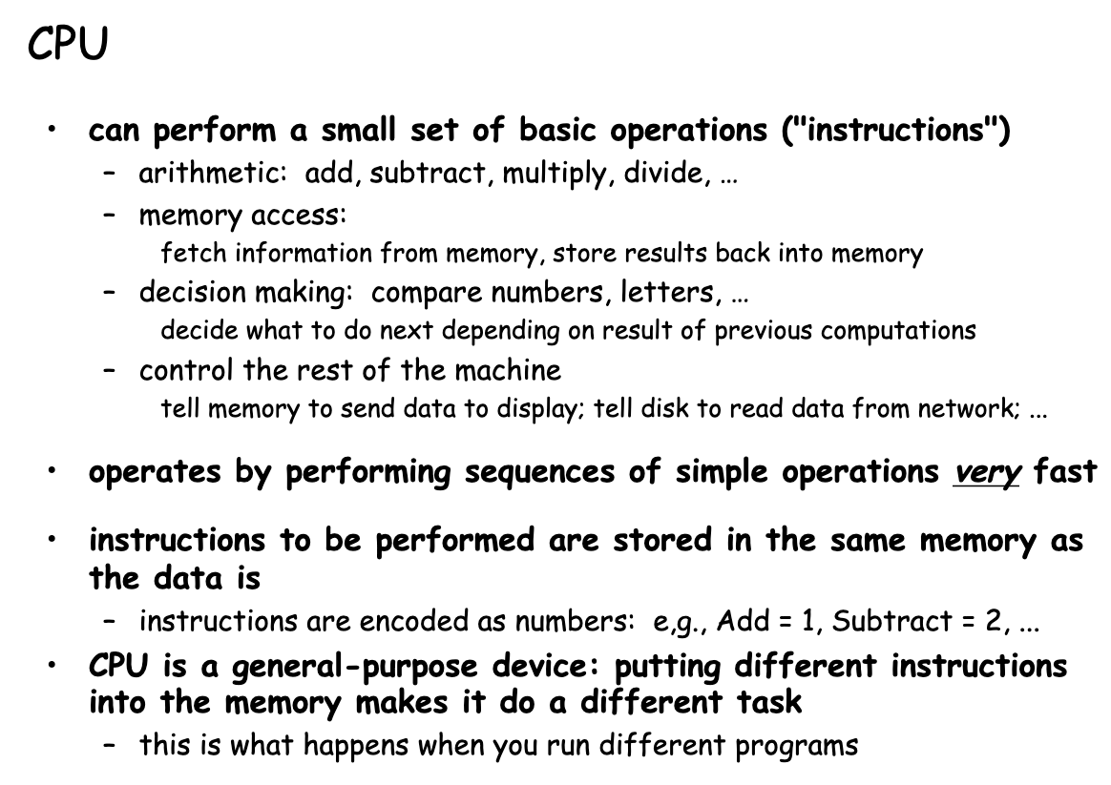
CPU

Slide 7
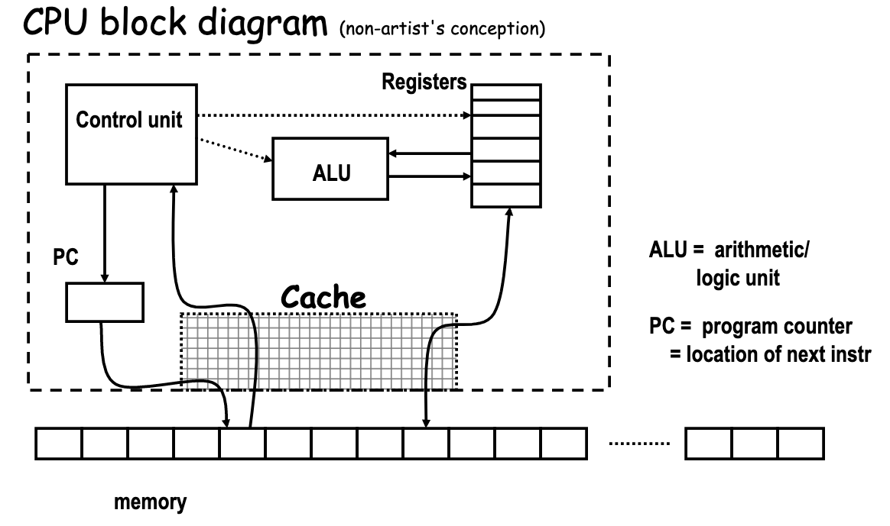
CPU

Slide 8
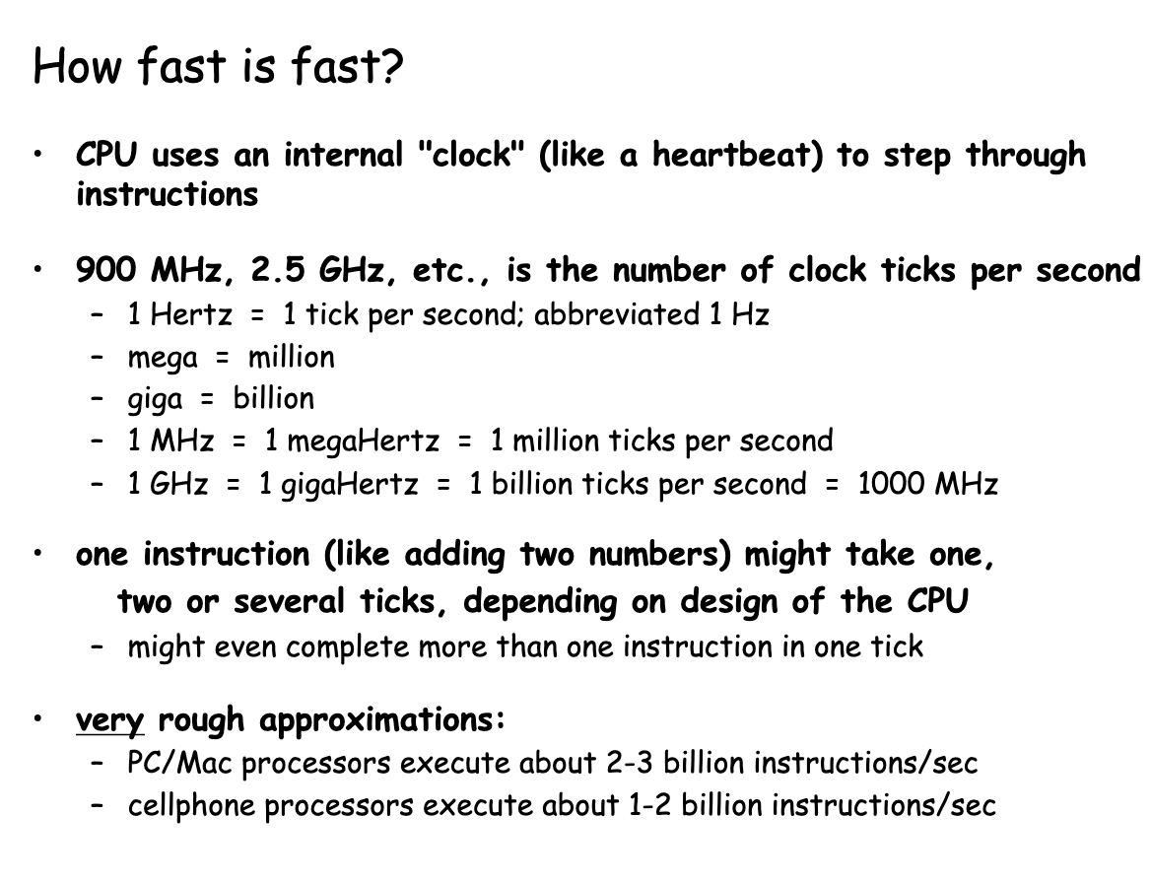
CPU

Slide 9
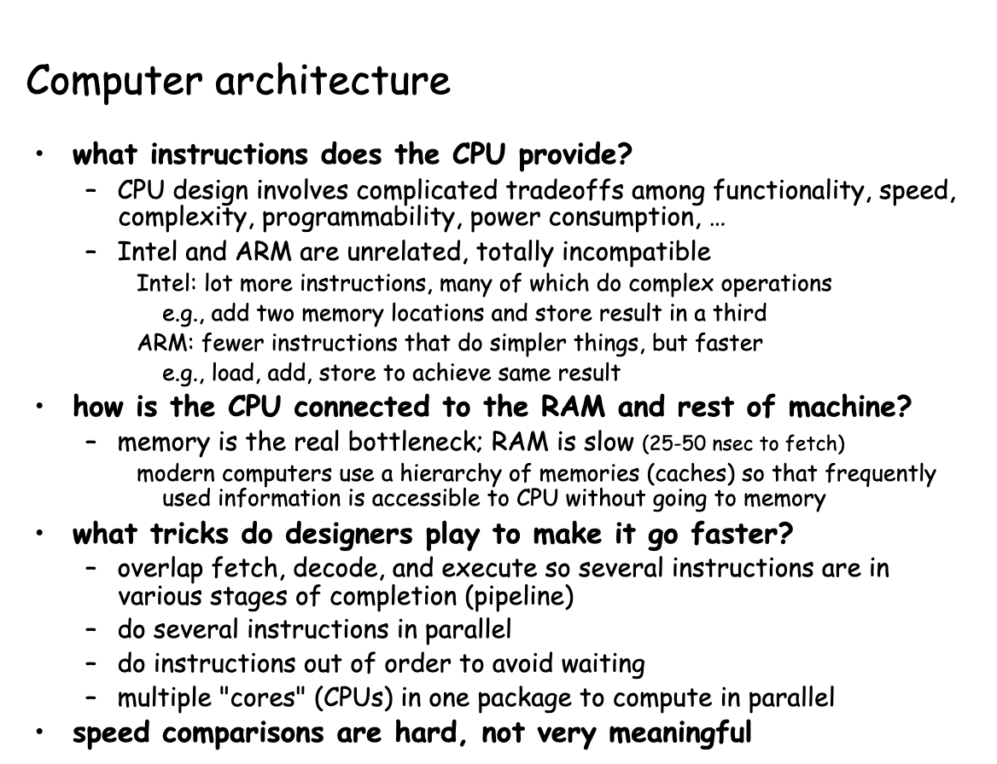
Computer architecture

Slide 10
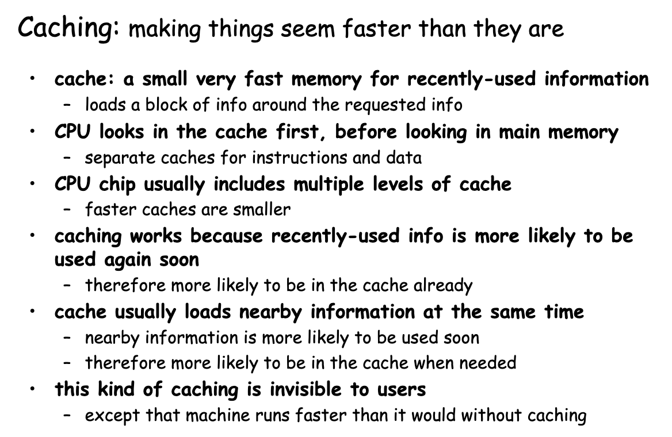
CPU architecture

Slide 11
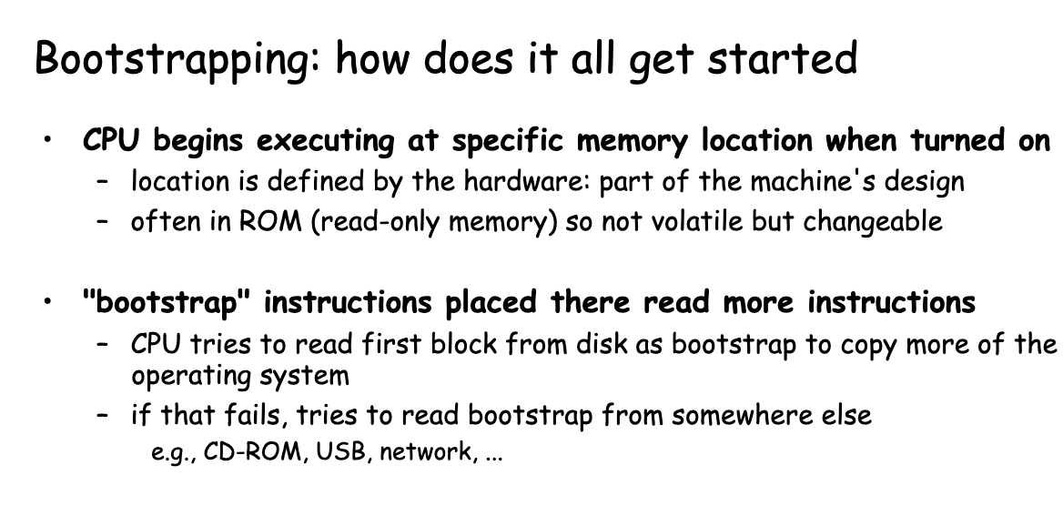
Bootstrapping

Slide 12
Software basics

Slide 13
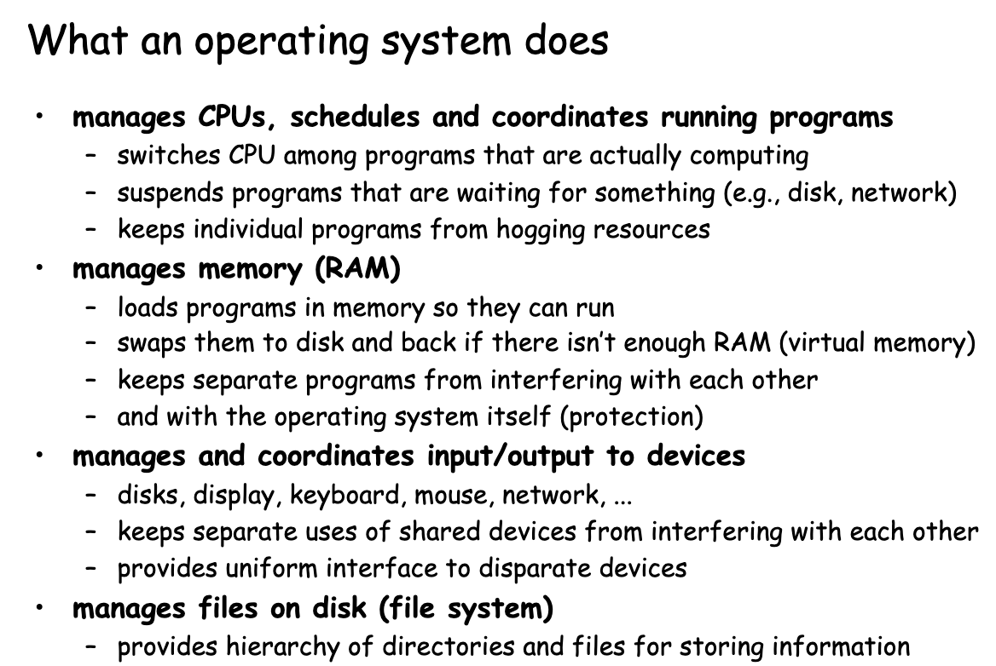
OS

Slide 14
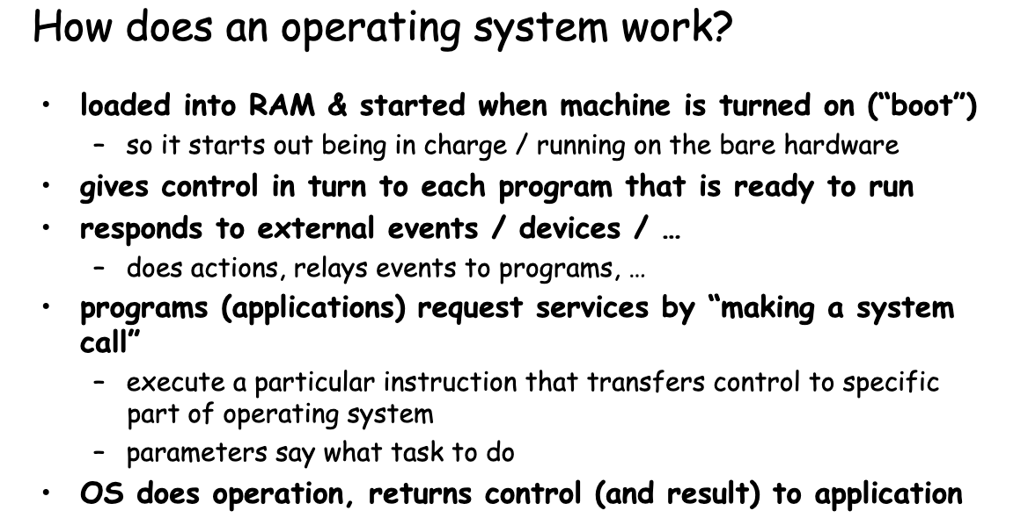
OS

Slide 15
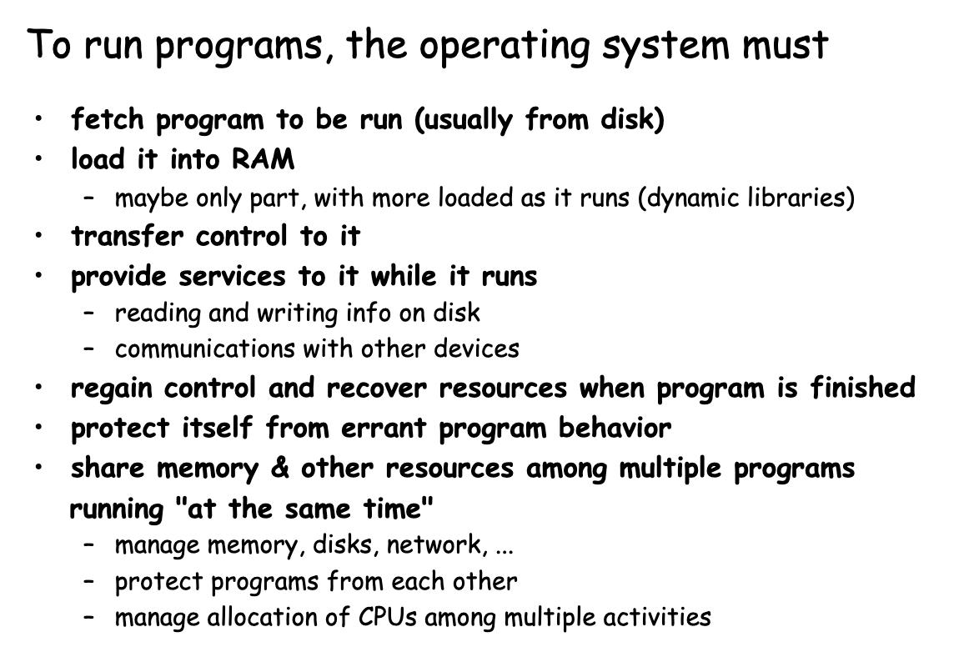
How to run programs?

Slide 16
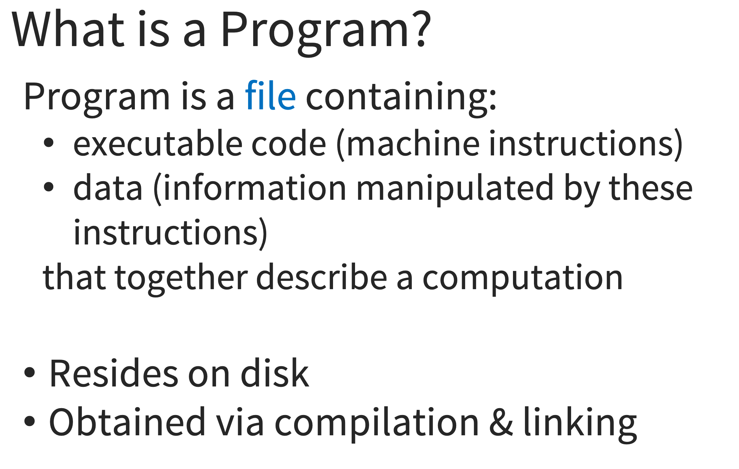
Programs

Slide 17
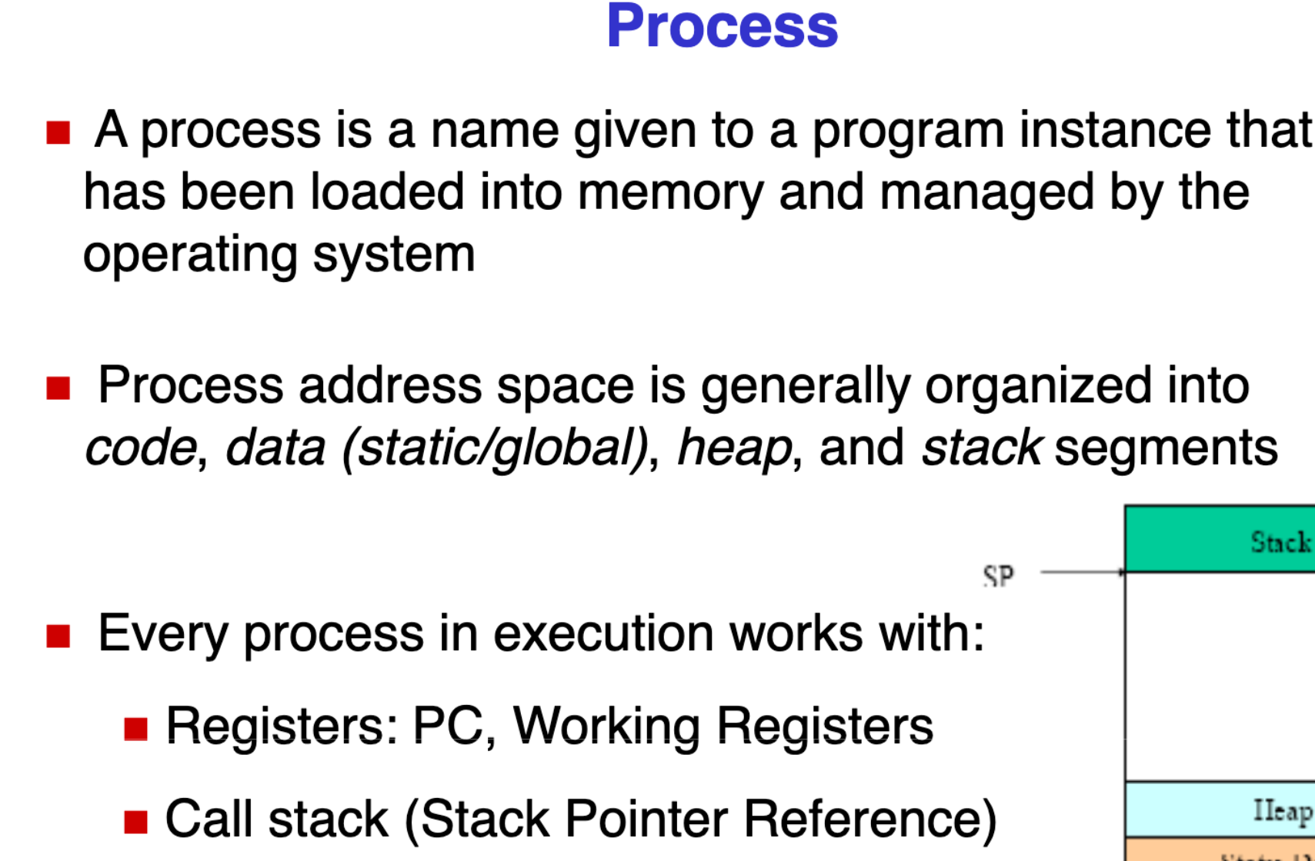
Process

Slide 18
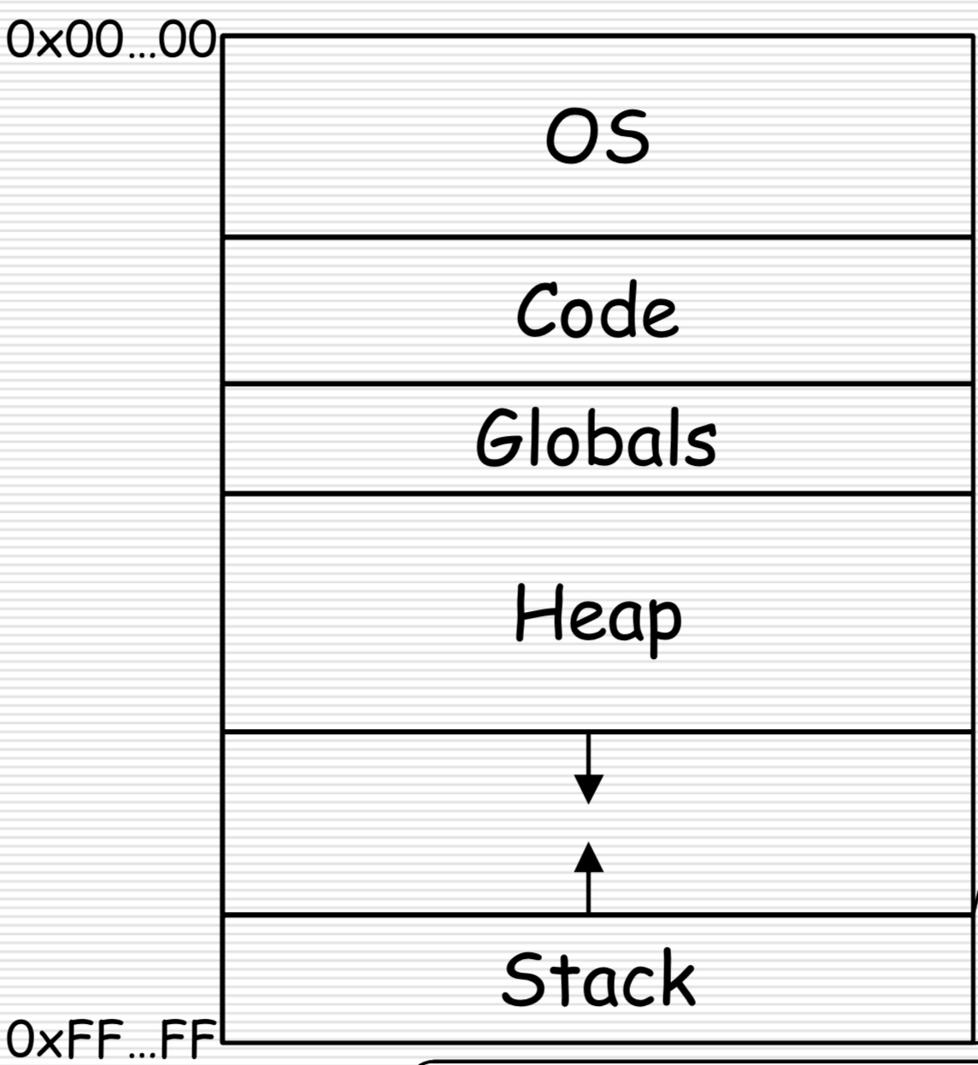
Process

Slide 19
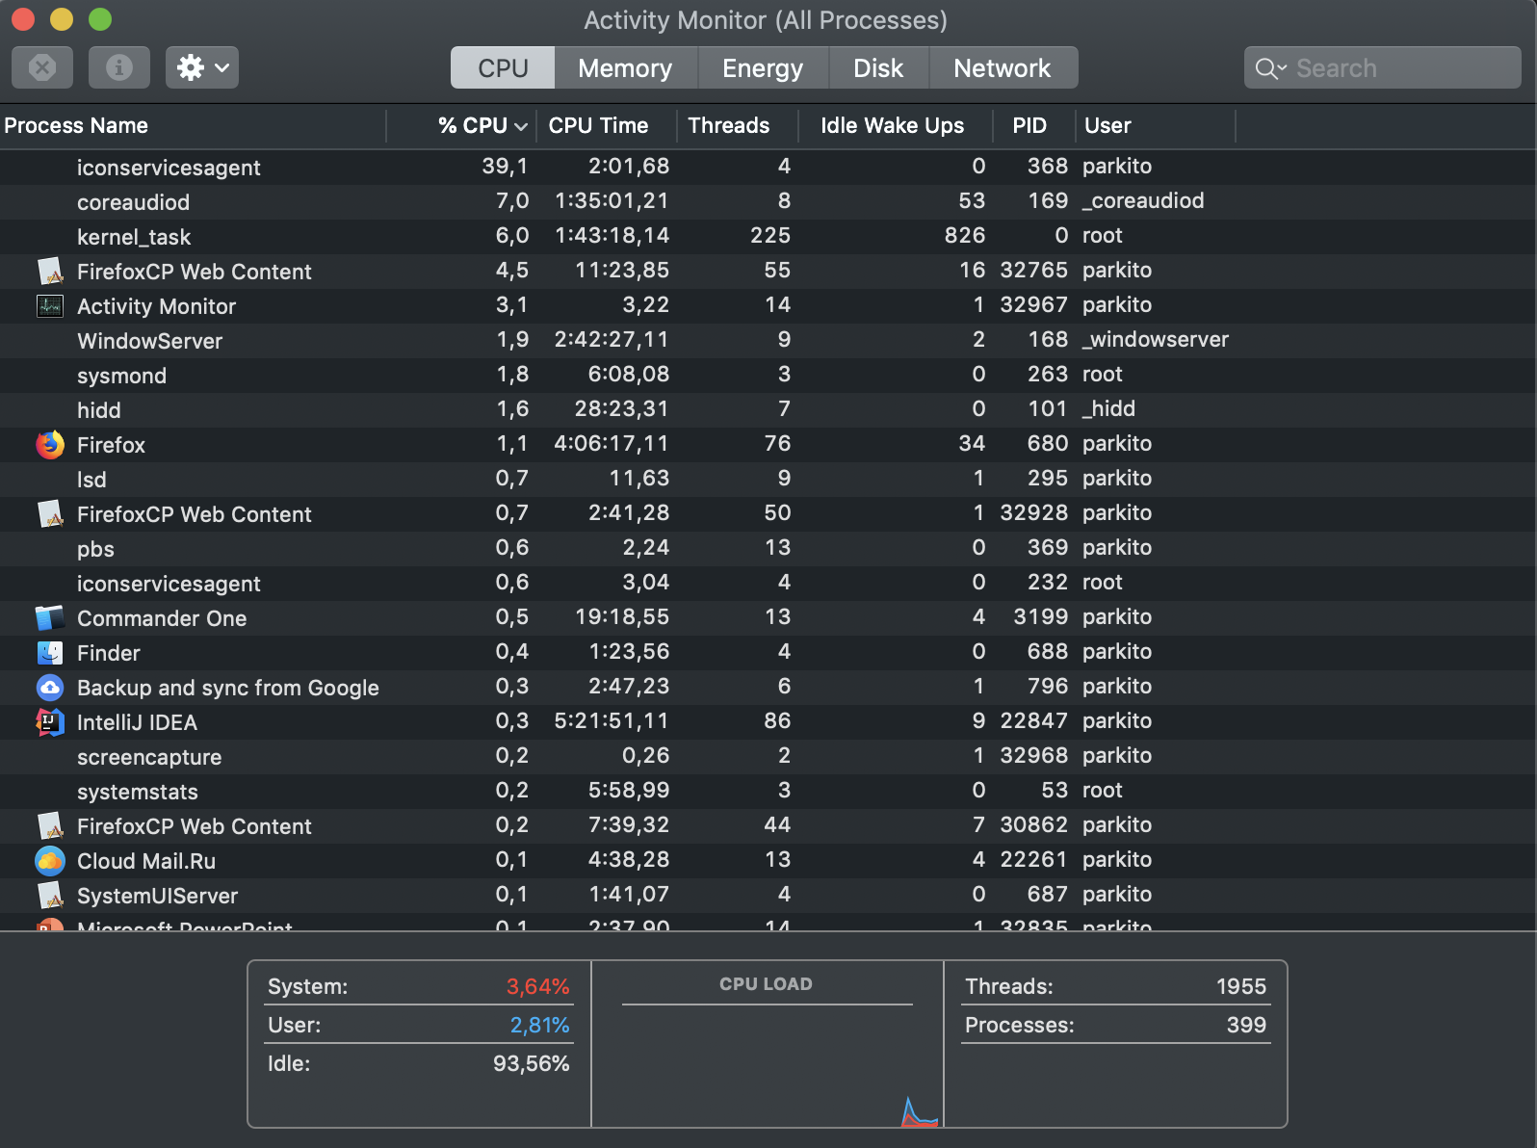
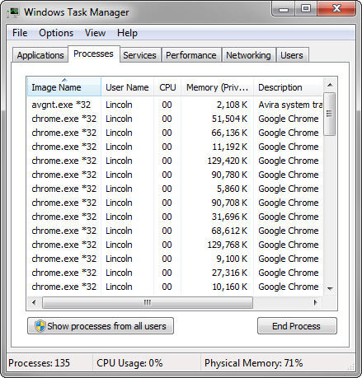
Processes

Slide 20
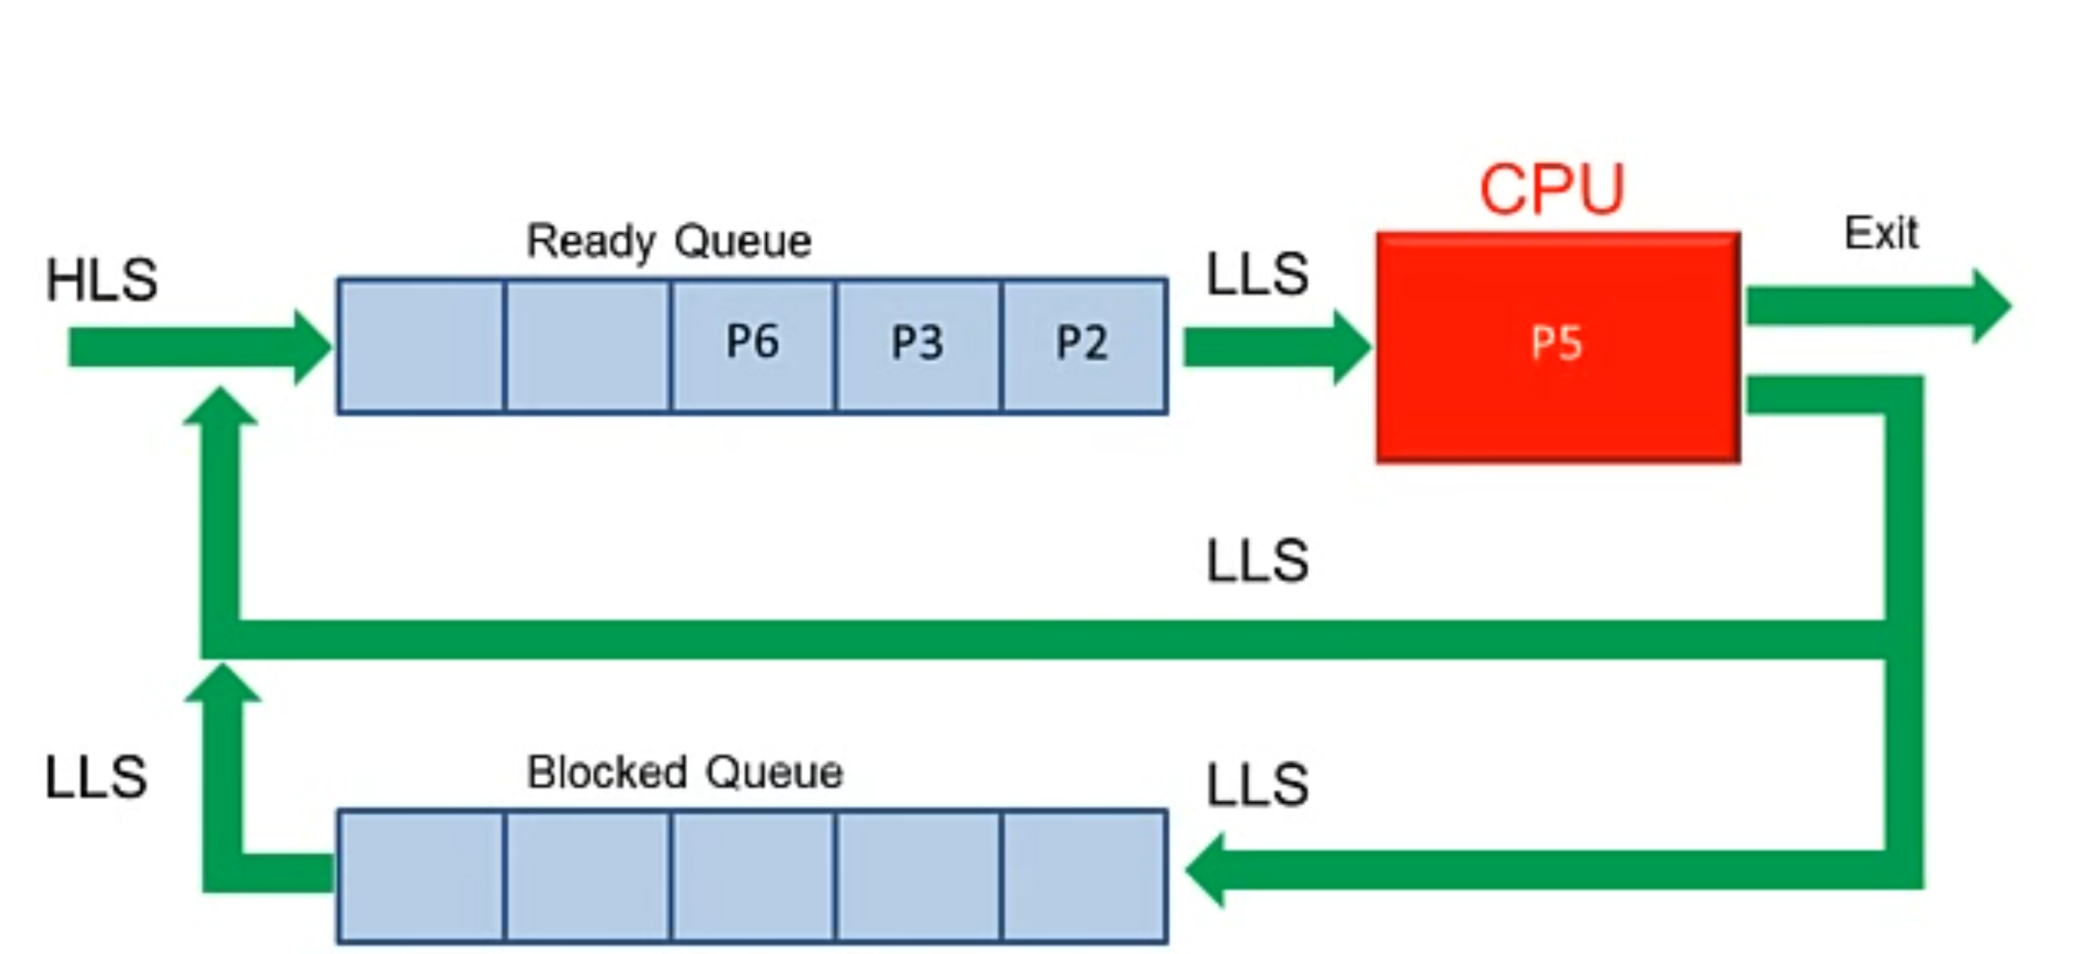
How processors work?

Slide 21
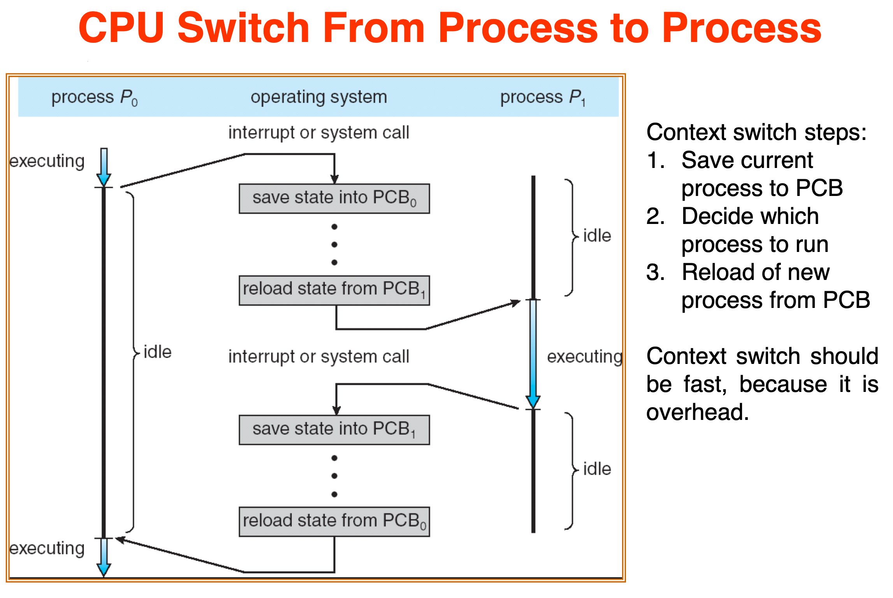
How processors work?

Slide 22
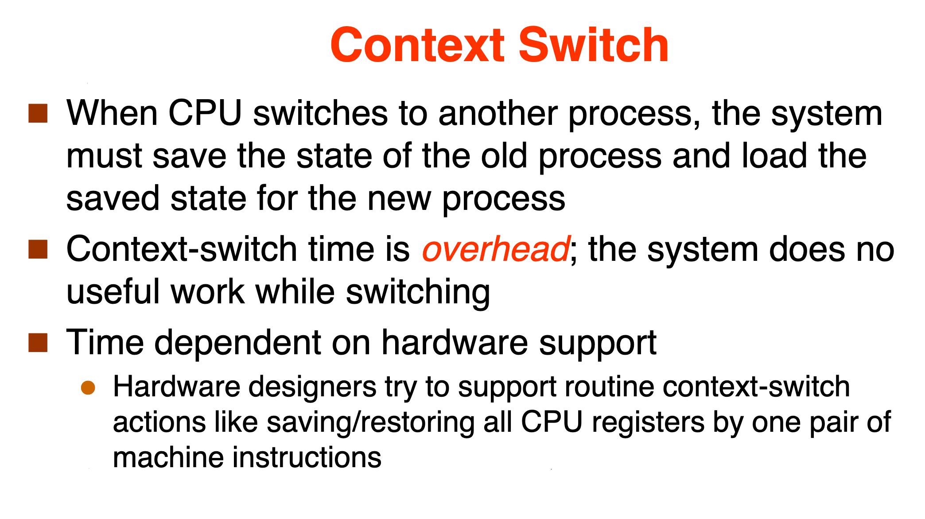
How processors work?

Slide 23
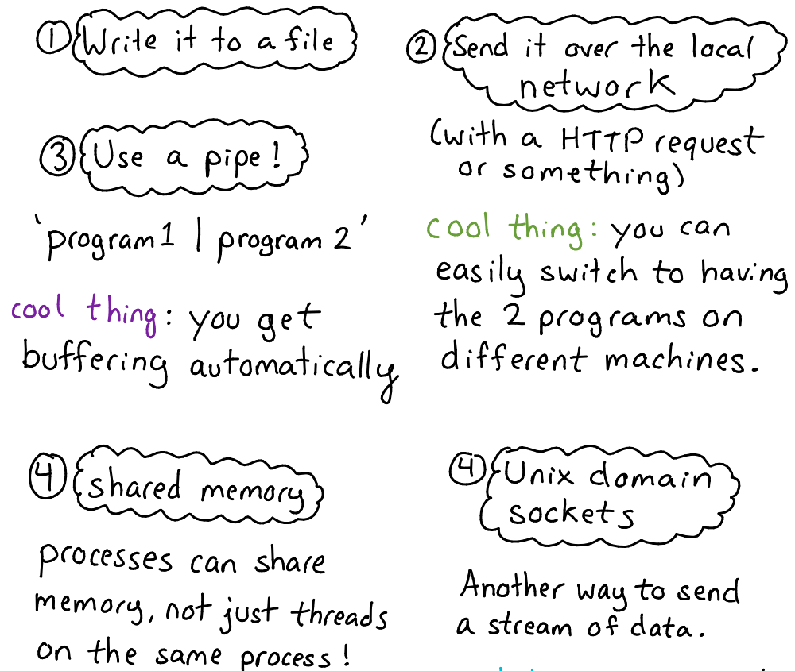
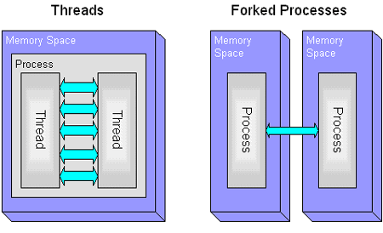
Inter-process communications

Slide 24
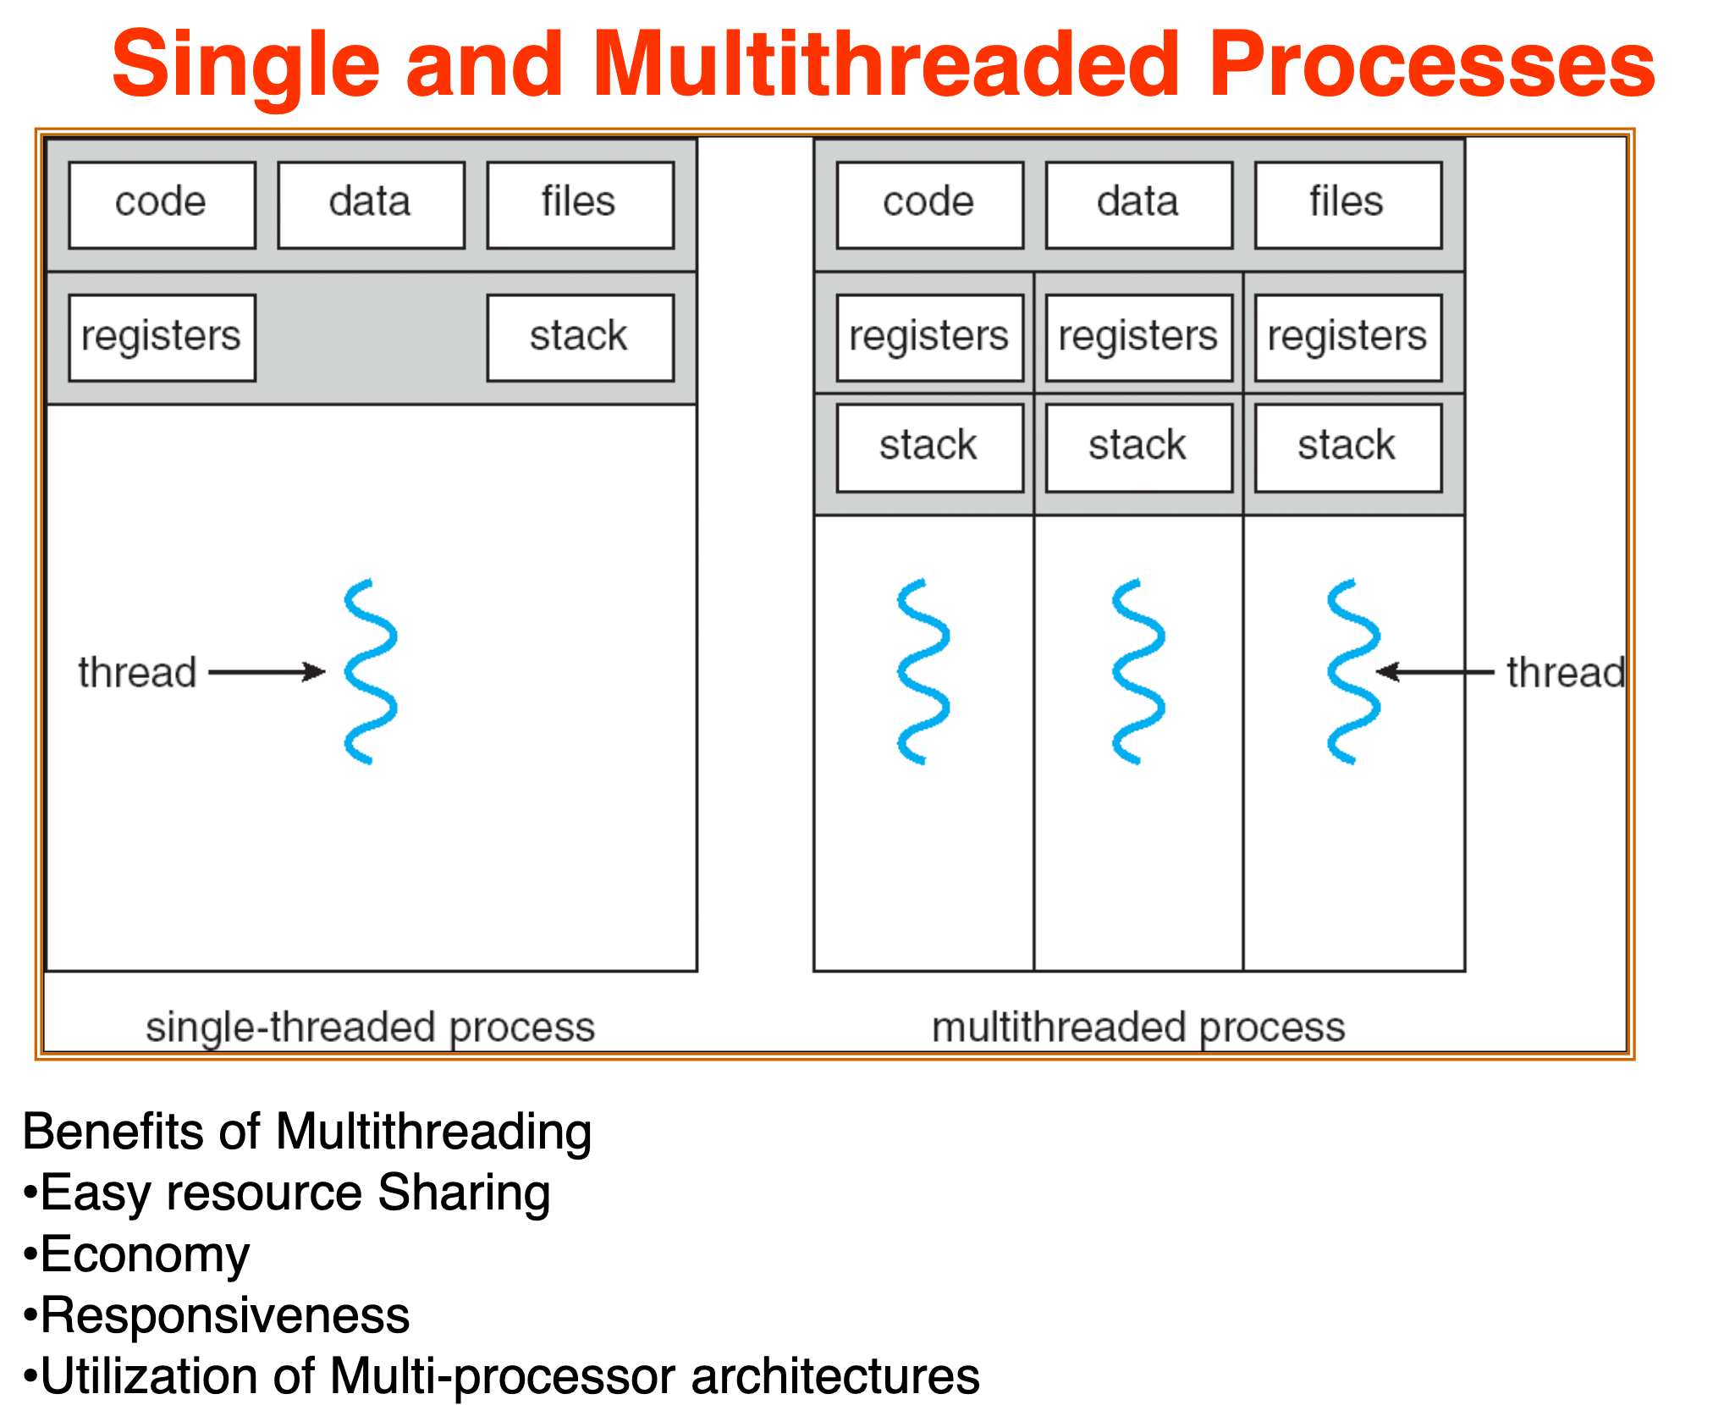
Threads

Slide 25
Threads

Slide 26
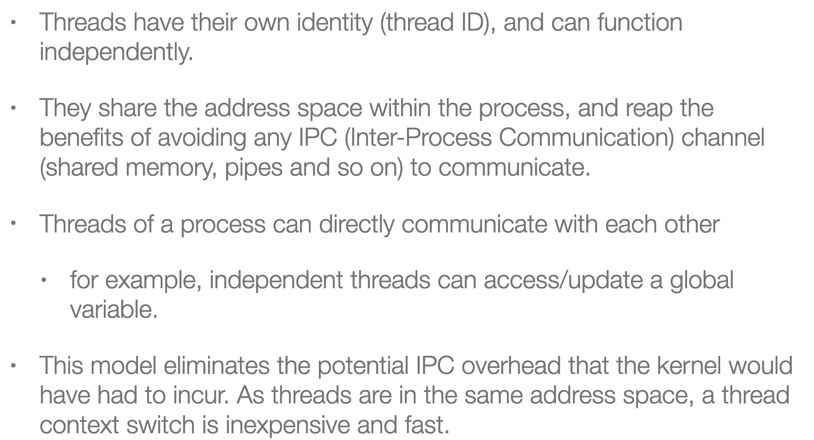
Threads

Slide 27
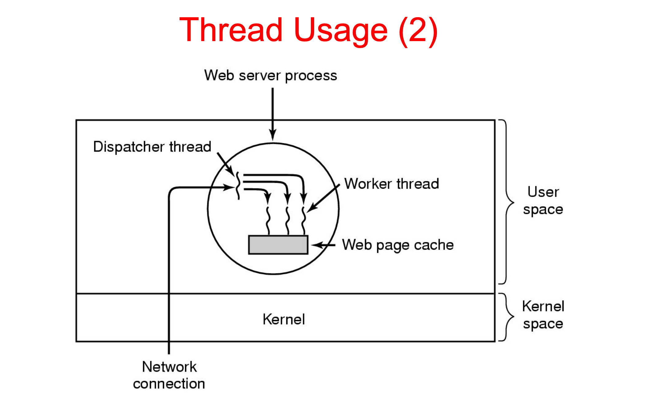
How processors work?

Slide 28
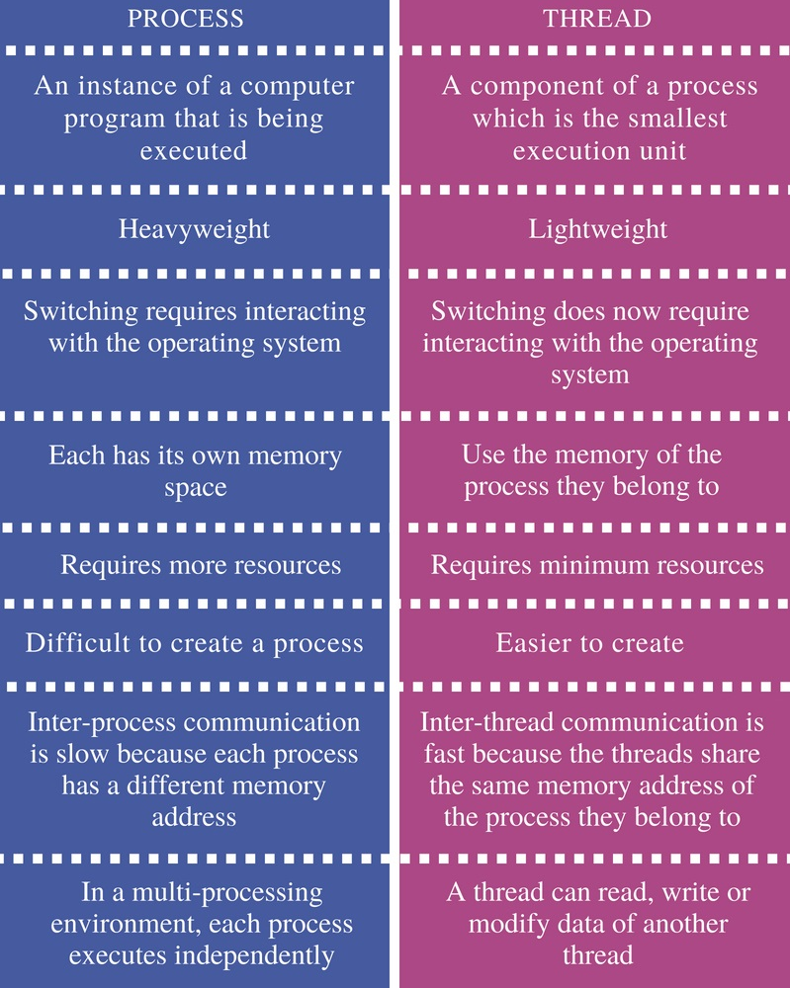
Inter-process communications

Slide 29
Java basics

Slide 30
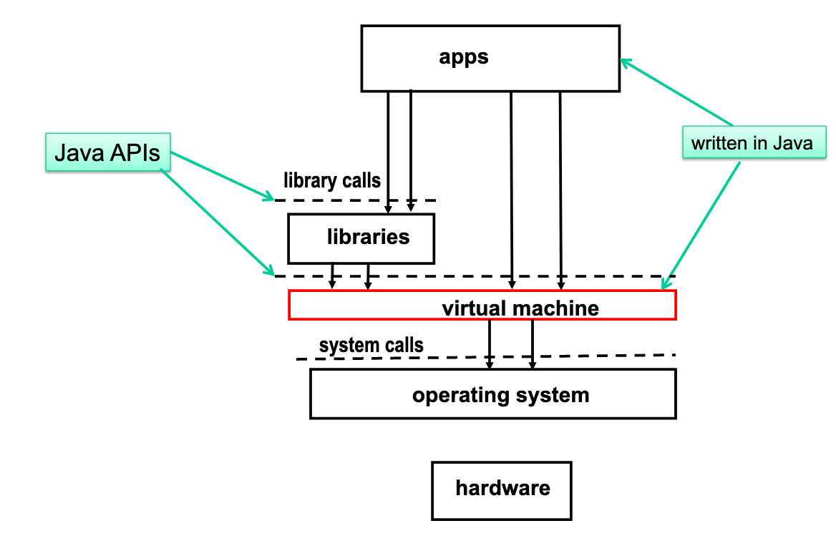
JVM execution architecture

Slide 31
How processors work?

Slide 32
Concurrent computing is a form of computing in which several computations are executed during overlapping time periods—concurrently—instead of sequentially (one completing before the next starts)
Definition

Slide 33
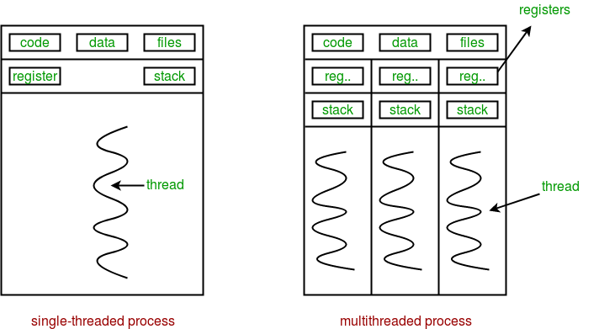
Sequential vs concurrent

Slide 34
Performance

Slide 35
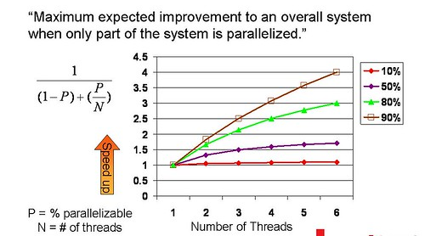
Amdahl's law

Slide 36
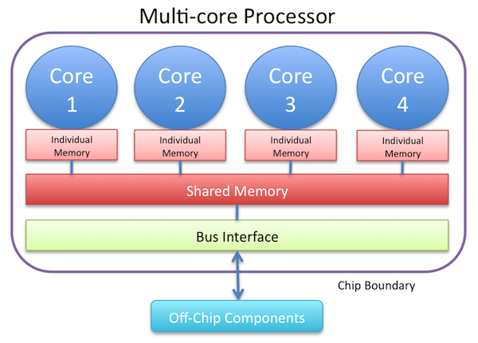
Resource utilization

Slide 37
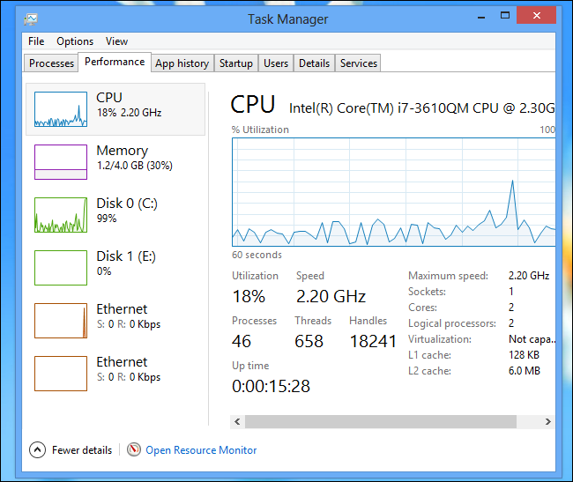
Resource utilization

Slide 38
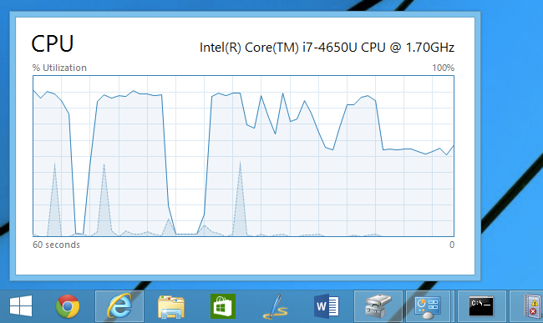
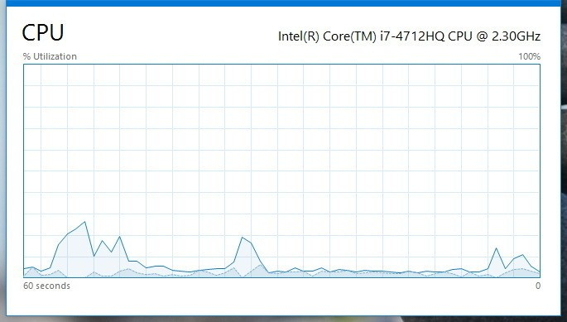
Resource utilization

Slide 39
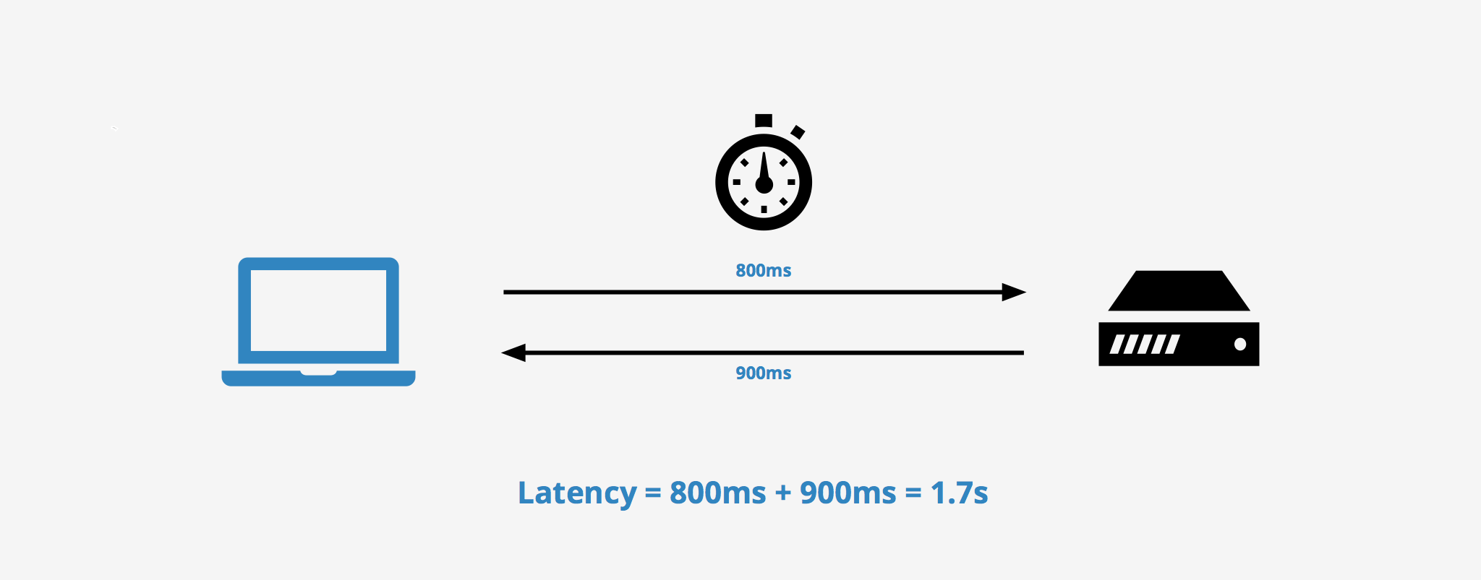
Latency

Slide 40

Modern way

Slide 41
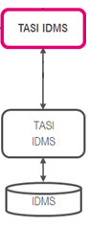
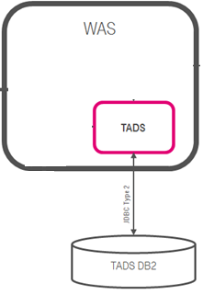

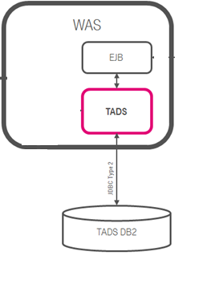
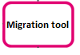

Concurrent Dijkstra algorithm

Slide 42
Multi thread migration

Slide 43
Single thread migration
7h21 min 1.7 r/s

Slide 44
Multi thread migration

Slide 45
Multi thread migration
7h21 min 1.7 r/s
28 min 23 r/s

Slide 46

The show begins

Slide 47
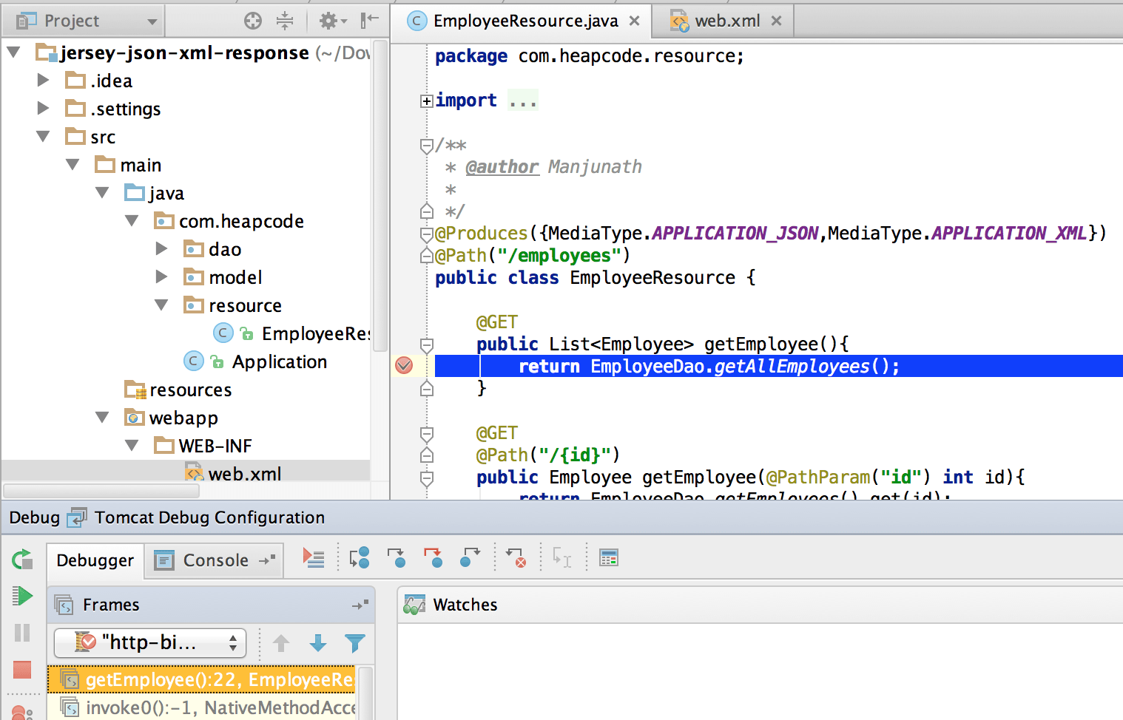
#1 Difficult to debug

Slide 48
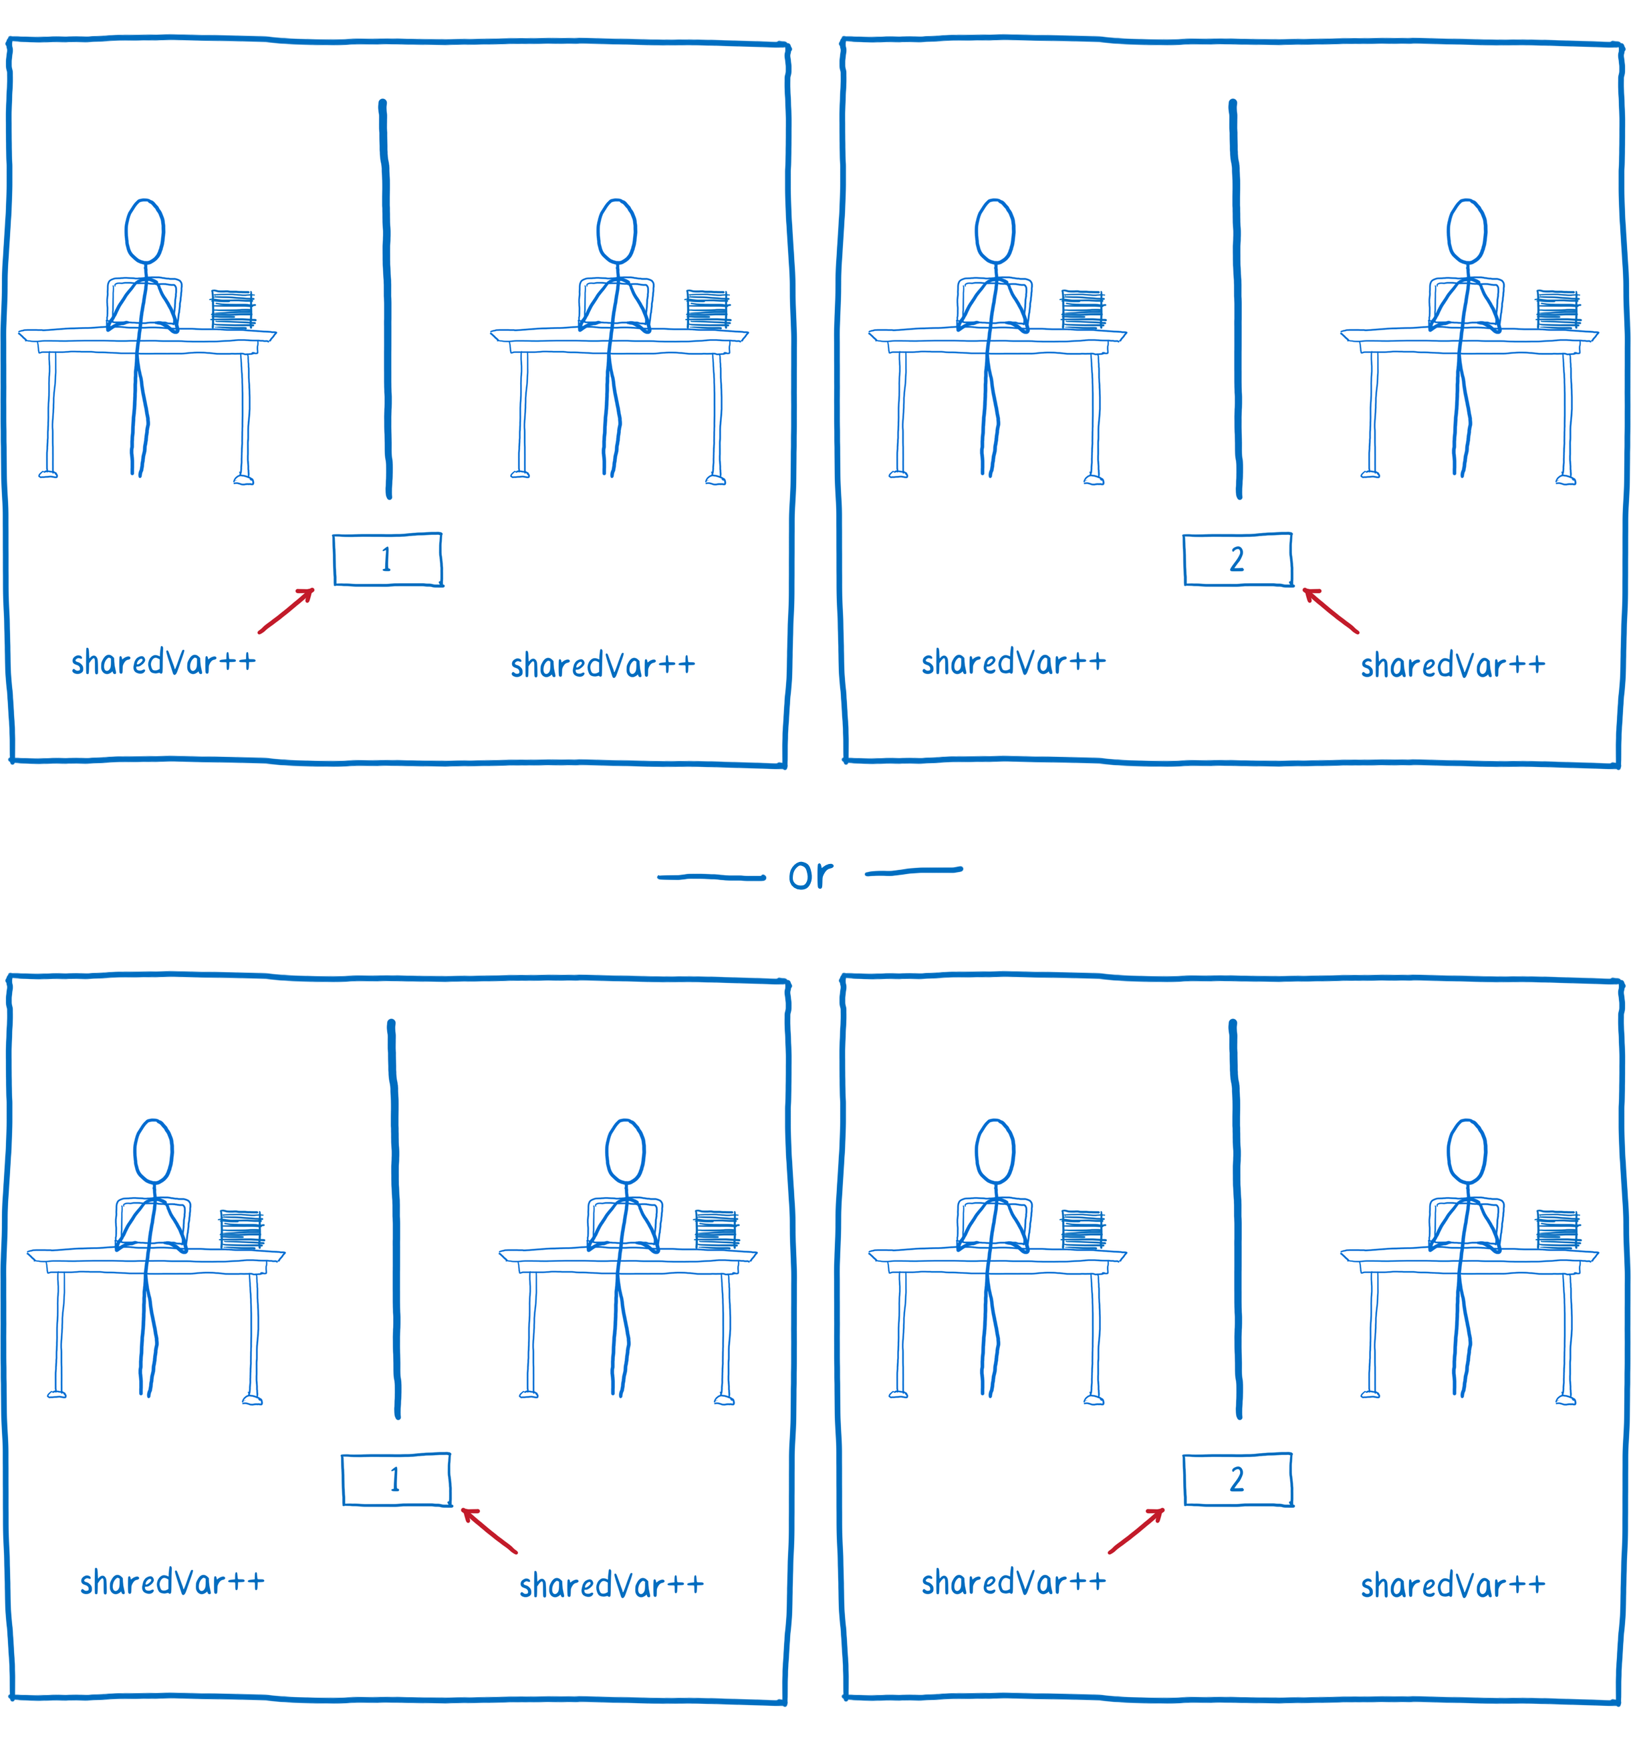
#2 Race condition

Slide 49
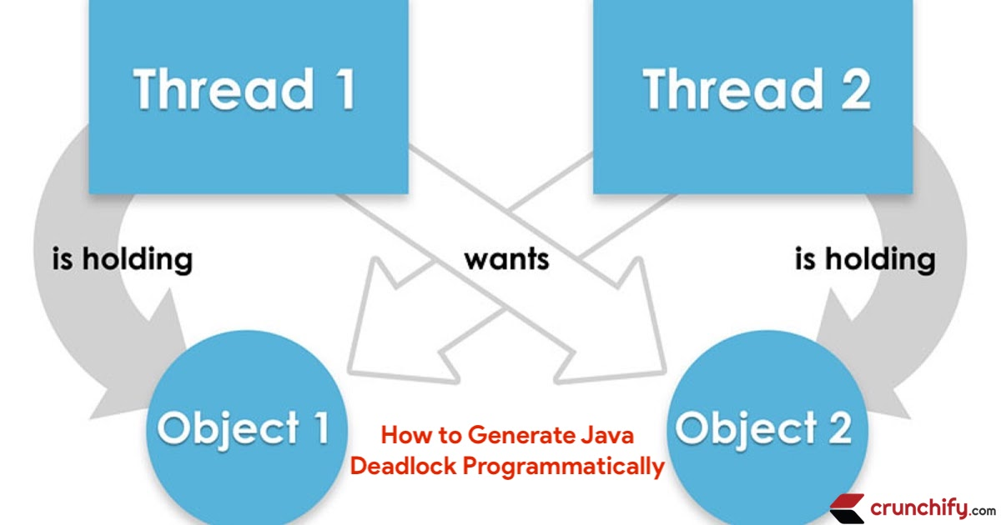
#3 Dead locks

Slide 50
Concurrency mad stuff
“But I don’t want to go among mad people," Alice remarked. - "Oh, you can’t help that," said the Cat: "we’re all mad here. I’m mad. You’re mad." - "How do you know I’m mad?" said Alice. - "You must be," said the Cat, "or you wouldn’t have come here.”
Alice's Adventures in
Wonderland by Lewis Carroll

Slide 51
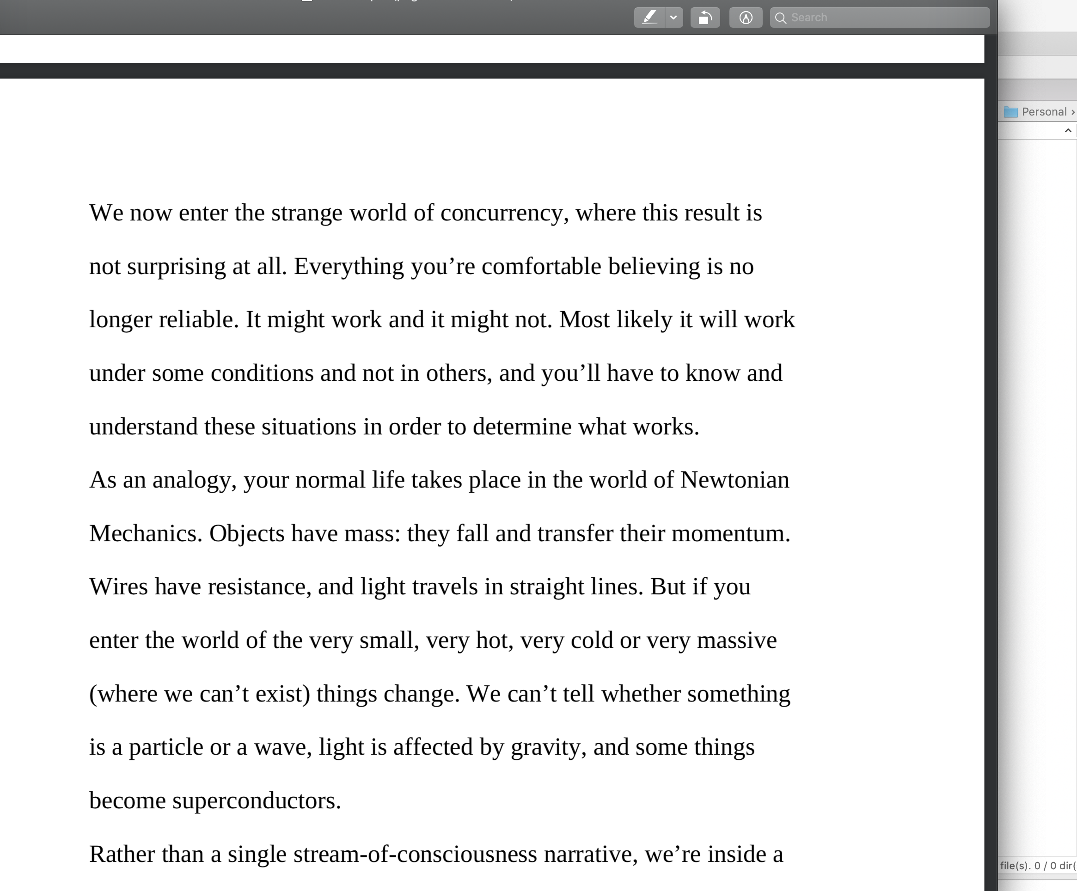

Dev practices
On Java 8 by Bruce Eckel

Slide 52
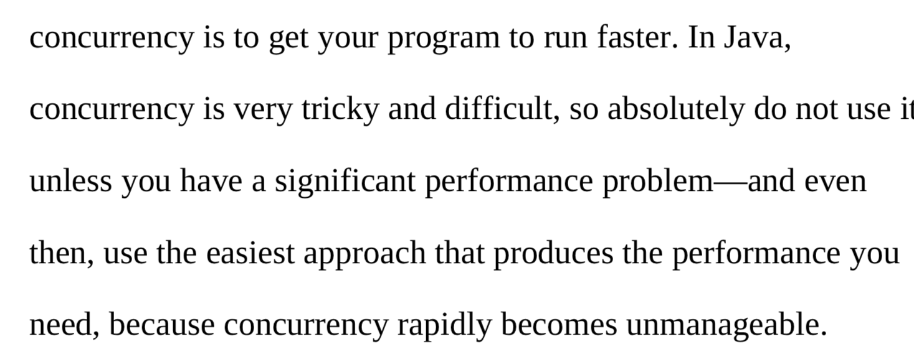

Dev practices
On Java 8 by Bruce Eckel

Slide 53
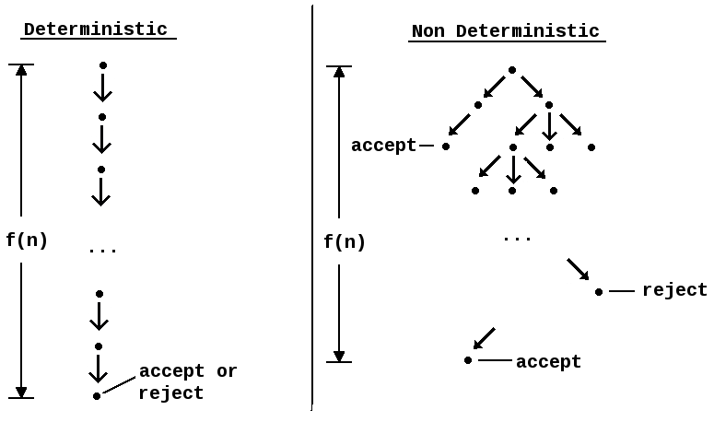
#4 Non deterministic behavior

Slide 54
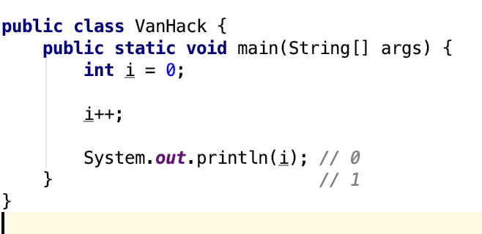
#4 Non deterministic behavior

Slide 55
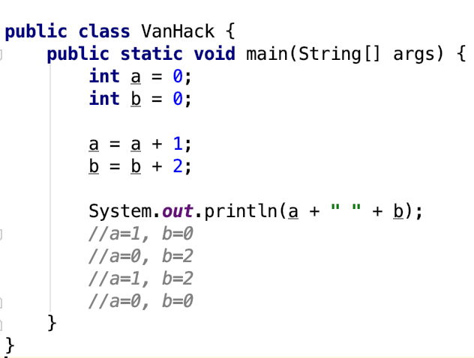
#4 Non deterministic behavior

Slide 56
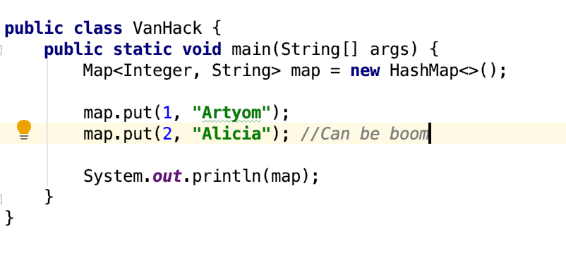
#4 Non deterministic behavior

Slide 57
Are you still here?
Twas brillig, and the slithy toves Did gyre and gimble in the wabe: All mimsy were the borogoves, And the mome raths outgrabe
Jabberwocky by Lewis Carroll

Slide 58

Let’s continue?

Slide 59
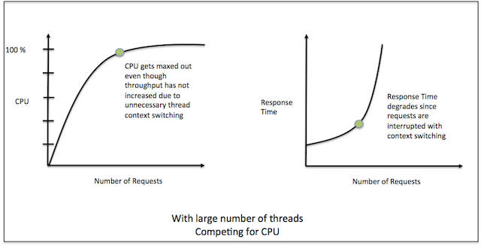
#5 Performance degradation

Slide 60
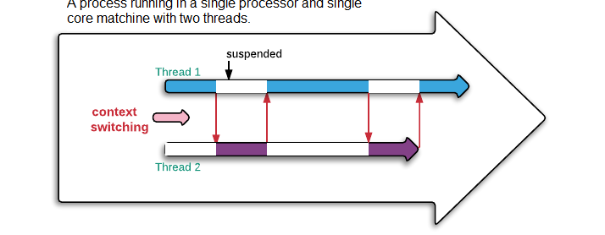
#5 Performance degradation

Slide 61
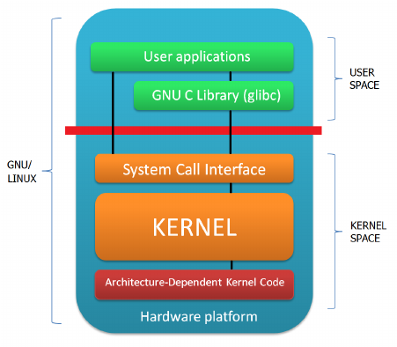
#6 OS limitation

Slide 62

Stop it? Hell no…

Slide 63

#7 Hardware unpredictable optimizations

Slide 64
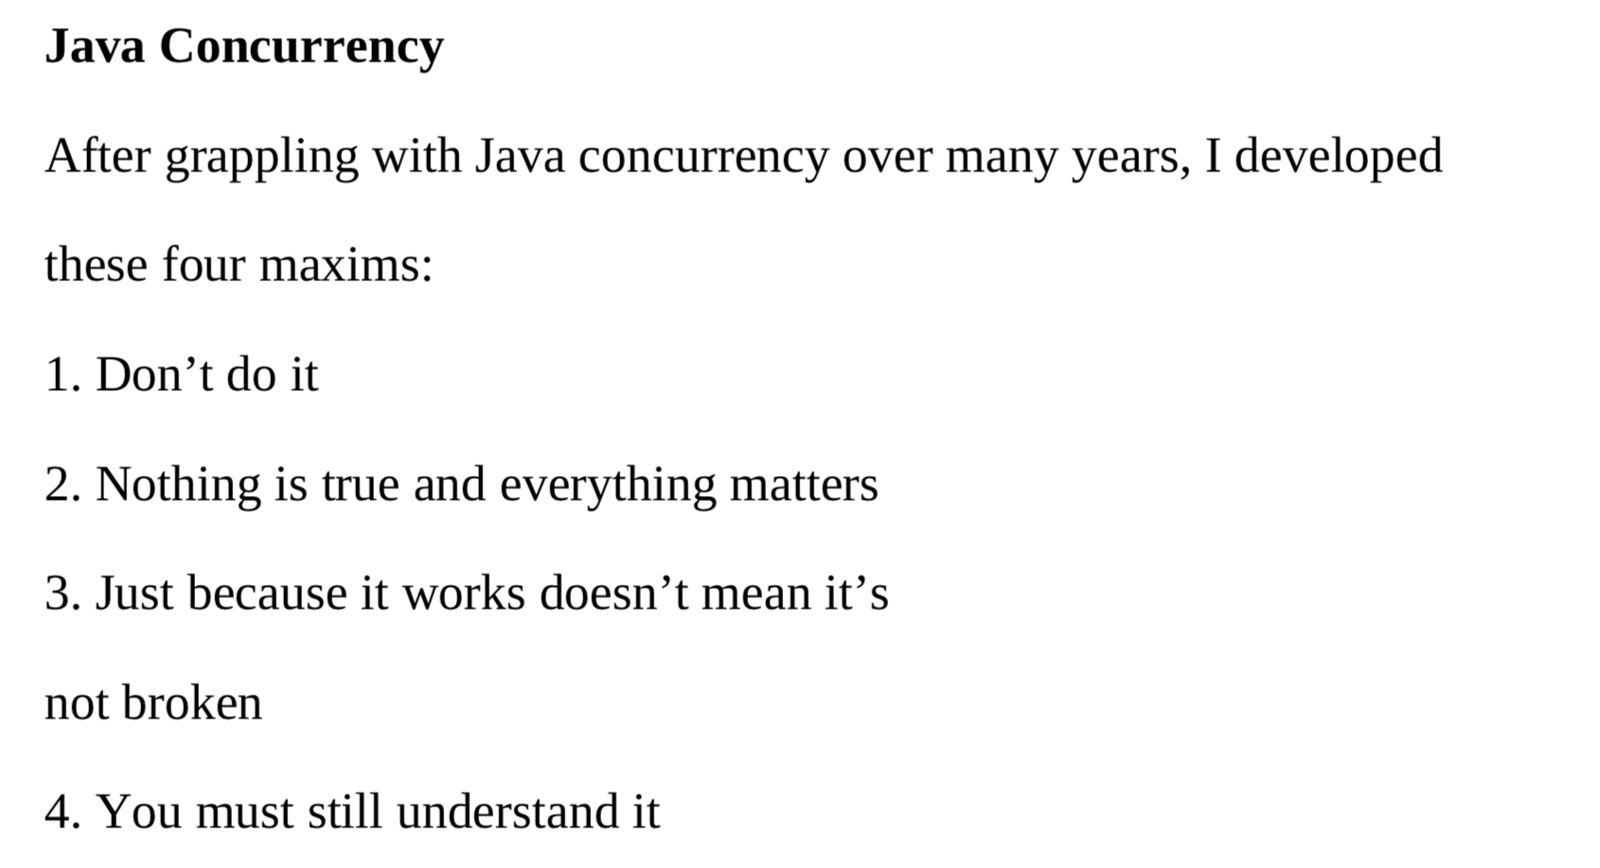
Concurrency in real world
On Java 8 by Bruce Eckel

Slide 65
Conclusion
Concurrency is powerful practice, you can achieve a lot using it
Don’t use concurrency if you can avoid it
Use best practices by experts
Use frameworks with big professional community
Minimize synchronization and data sharing
Perform load and stress testing
Use as much as possible existed solutions
Don’t forget about mad world and wonders

Slide 66
Resources
Java concurrency in practice (Brian Goetz )
On Java 8 (Bruce Eckel)
The Art of Multiprocessor Programming (Maurice Herlihy , Nir Shavit )

Slide 67

THANK YOU!
artyom-karnov@yandex.ru, Saint-Petersburg, 2019

